Slide 1
Propositional Logic
Knowledge-based System Engineering
Nurul Fajrin Ariyani
nf.ariyani@its.ac.id

Slide 2
World
Knowledge
Logical Representation
Reasoning

Slide 3
Proposition
A statement that is either true or false, but not both simultaneously.
Real-world facts are converted into symbols (typically using letters such as P, Q, and R).
A statement can be combined with another using logical operators.
Truth tables are used to evaluate the truth values ​​of combined propositions.
Inference (or reasoning) is the process of drawing new conclusions from knowledge already present in the Knowledge Base (KB).

Slide 4
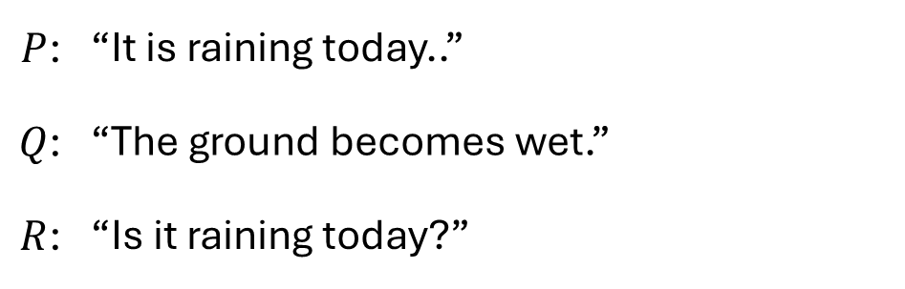
Example
$P$: | “It is raining today..”
$Q$: | “The ground becomes wet.”
$R$: | “Is it raining today?”
Which one is a proposition?

Slide 5
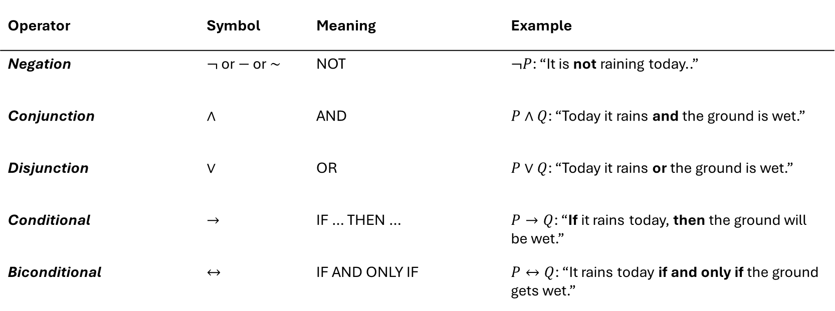
Basic Logical Operators
Operator | Symbol | Meaning | Example
Negation | $¬$ or $−$ or $\sim$ | NOT | $¬P$: “It is not raining today..”
Conjunction | $$∧$$ | AND | $P∧Q$: “Today it rains and the ground is wet.”
Disjunction | $$∨$$ | OR | $P∨Q$: “Today it rains or the ground is wet.”
Conditional | $$→$$ | IF … THEN … | $P→Q$: “If it rains today, then the ground will be wet.”
Biconditional | $$↔$$ | IF AND ONLY IF | $P↔Q$: “It rains today if and only if the ground gets wet.”

Slide 6

Why is it studied in Knowledge Representation?
World
Knowledge
Logical Representation
Reasoning
Consistent
Query
Entailment
Conflict
Primary objective: to make knowledge explicit, structured, and testable.
In KR, propositional logic is used to represent simple facts and Boolean rules, and then to answer questions such as “Is this rule consistent?” and “Does this conclusion follow from the KB?”
$$KB⊨α$$

Slide 7
Learning Outcomes
Translating knowledge (expressed in natural language) into logical propositions and formulas.
Constructing a knowledge base containing facts and rules.
Distinguishing between satisfiability, unsatisfiability, validity, and entailment.
Using solvers to answer queries, find counterexamples, and debug conflicts.
Explaining the limitations of propositional logic and the need for First-Order Logic (FOL).
Tools: SymPy, Z3, PySAT

Slide 8
Process Flow
Representation
Proposition, connectives, syntax-semantics, model, satisfiability.
Inference
Knowledge base, entailment, inference rules, CNF, resolution.
Automated Reasoning
SAT solving, query answering, counterexample, unsat core, assignment.

Slide 9


Case Study: Academic Advising (FRS)
System question:
"Can students take Undergraduate Thesis (TA)?"
Simple policy:
Pass Programming Fundamentals
Pass Data Structures
Pass Algorithm Design & Analysis
Meet the minimum credit requirement
No academic hold
EligibleTA ⇔ P $∧$ S $∧$ A $∧$ C $∧¬$H

Slide 10
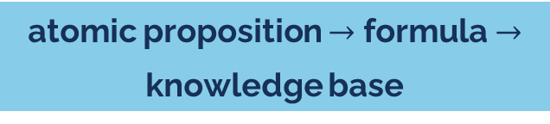
From Sentence to Proposition
Principle of representation
A proposition must have a value of True or False. Do not create overly complex propositions—for example, "the student has met all prerequisites, except that there is still a hold."
Proposition | Sentence
P | Passed Programming Fundamentals
S | Passed Data Structures
A | Pass Algorithm Design & Analysis
C | Meeting the minimum number of credits (SKS)
H | Has an academic hold
T | Eligible to take the undergraduate thesis
atomic proposition $→$ formula $→$ knowledge base
A good representation makes rules easy to test, modify, and explain.

Slide 11
Logical Connectives
¬P
P ∧ S
P ∨ S
not P
P and D
P or D
Not passed
pass two prerequisites
pass one of prerequisites
P → T
T ↔ R
if P then T
T iff R
implication rule
bidirectional definition

Slide 12
Common Mistake: Implication ≠ Bidirectional
Sentence: “If a student is eligible for the undergraduate thesis, then they have met the minimum credit requirement.”
T → C
C → T
Not equivalent
Correct: eligibility requires that credit requirements are met.
Incorrect: merely meeting the credit hour (SKS) requirement is not enough to be eligible for the undergraduate thesis (TA).
Class discussion: Name two academic rules that are often misrepresented as two-way implications.

Slide 13
Syntax vs Semantics
Syntax
Semantics
(P ∧ C) → T
P=True, C=True, T=False
How formulas are written according to the rules of logical grammar.
Does this assignment make the formula True or False?

Slide 14
Model, SAT, UNSAT, Valid
Model
assignment that makes the formula or KB value True
SAT
there is at least one model that meets the formula/KB
UNSAT
There is no model that can satisfy all the constraints.
Valid
The formula is correct in all assignments
SAT: P ∨ Q
UNSAT: P ∧ ¬P
VALID: P ∨ ¬P
Notes:
SAT singkatan dari “Satisfiable” problem, sedangkan UNSAT “Unsatisfiable” problem.

Slide 15
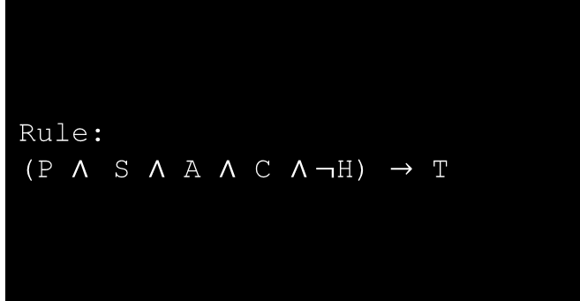
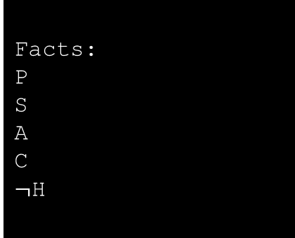
Knowledge Base: Facts $+$ Rules
KB = { facts, rules }
Facts:
P
S
A
C
$¬$H
Rule:
(P $∧$ S $∧$ A $∧$ C $∧¬$H) $→$ T
Query:
T ?
Reasoning goal: Do all models that satisfy KB also make T evaluate to True?

Slide 16

Logical Entailment
$$KB⊨α$$
Meaning: every model that satisfies KB also satisfies 𝜶.
KB ⊨ T
KB ⊭ T
T is proven from all facts and rules.
Conclusion T can be drawn from KB.
There is a counterexample: KB True, but T False. The conclusion T cannot be drawn from KB.

Slide 17
Inference Rules
Modus Ponens
Chain of Reasoning
In Knowledge Representation (KR), an inference rule describes how the system derives new knowledge from existing facts and rules.
A → B
B → C
C → D
A
∴ D
P
P → Q
∴ Q
Note: Modern solvers do not always “explain” their steps the way humans do, but the underlying logical principles remain the same.
13

Slide 18


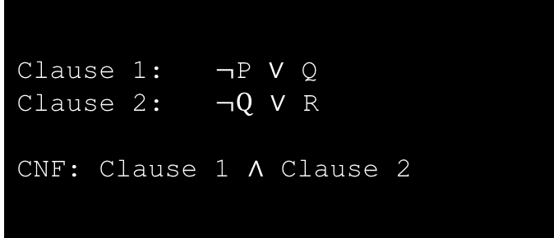

CNF: Format required by the SAT solver
P $→$ Q $≡$ $¬$P $∨$ Q
CNF = Conjunctive Normal Form
Conjunction of clauses
Each clause is a disjunction of literals.
(P $→$ Q) $∧$ (Q $→$ R)
Clause 1: $¬$P $∨$ Q
Clause 2: $¬Q$ $∨$ R
CNF: Clause 1 $∧$ Clause 2
P $→$ Q $≡$ $¬$P $∨$ Q

Slide 19


An Intuitive Understanding of Resolution
$¬$P $∨$ Q
If P is true, then the clause ¬P ∨ Q can only be true if Q is true.
Q
P
Resolution is a fundamental concept in theorem proving based on propositional logic.
$¬$Q $∨$ R
R

Slide 20

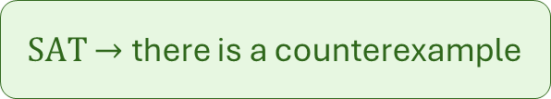


Entailment as a SAT Problem
(Proof by Refutation)
To prove : KB $⊨$ Q
Interpretation of solver results
UNSAT $→$ KB $⊨$ Q
Check: KB $∧$ $¬$Q
SAT $→$ there is a counterexample
This is the bridge from propositional logic to SAT solvers.

Slide 21
Tutorial SAT Solver: Setup
Tool utama: Z3
Z3 is used for checking satisfiability, models, entailment, counterexamples, and unsat cores. SymPy is used for formula manipulation and CNF.
pip install z3-solver
Tool pendukung: SymPy
SymPy → formula manipulation
Z3 → automated reasoning
pip install sympy

Slide 22
Tutorial 1: Create KB di Z3
from z3 import *
P, S, A, C, H, T = Bools(
“fundprog_passed ”
“datstruct_passed ”
“paa_passed ”
“min_credit”
“academic_hold ”
“can_take_thesis”
)
solver = Solver()
# Eligibility rule
solver.add(T == And(P, S, A, C, Not(H)))
# Student facts
solver.add(P, S, A, C, Not(H))
print(solver.check())
Expected output
sat
This means that the facts and rules in the KB do not contradict each other (the KB is consistent).
KB is satisfiable

Slide 23
Tutorial 2: Viewing the Model
Expected output
# Check the model
model = solver.model()
print(model)
print(model.eval(T))
Sat
[can_take_thesis = True,
datstruct_passed = True,
paa_passed = True,
min_credit = True,
fundprog_passed = True,
academic_hold = False]
Student can take thesis: True

Slide 24
Tutorial 3: Check Entailment
If result KB ∧ ¬T is:
# Check the entailment
solver.push()
solver.add(Not(T))
print(solver.check())
solver.pop() # Delete the last item (-T) from the model
unsat
KB ⊨ T
There is no counterexample: all worlds that satisfy KB also make T true.

Slide 25
Tutorial 4: Counterexample & Incomplete Knowledge
sat
[can_take_thesis = True,
datstruct_passed = True,
paa_passed = True,
min_credit = True,
fundprog_passed = True,
academic_hold = False
]
# Check the entailment
solver2 = Solver()
solver2.add(T == And(P, S, A, C, Not(H)))
solver2.add(P, S, A, C) # H is unknown
solver2.add(Not(T)) # Try to make T False
print(solver2.check())
print(solver2.model()) # Ask Z3 to find a model that meet T=False
Meaning:
KB ⊭ T
An inability to prove T does not mean that ¬T is true. It is possible that knowledge is incomplete.

Slide 26
Tutorial 5: Detecting Conflict
Concrete examples: academic data differing across systems, conflicting approval rules, or unsynchronized access policies.
C = Bool(“sks_minimal_terpenuhi”)
solver = Solver()
solver.add(C)
solver.add(Not(C))
print(solver.check())
C ∧ ¬C
Inconsistent KB → the system cannot perform reasoning until the conflict is resolved.
unsat

Slide 27
Tutorial 6: Identifying the Cause of Conflict
from z3 import *
C = Bool(“min_credit”)
solver = Solver()
solver.set(unsat_core=True)
solver.assert_and_track(
C,
“academic_system”
)
solver.assert_and_track(
Not©,
“administrative_system”
)
print(solver.check())
print(solver.unsat_core())
Unsat core answer:
“Which part of the KB is causing the conflict?”
[academic_system,
administrative_system]
This transforms the solver from a mere SAT checker into a knowledge debugging tool.

Slide 28
Additional Tutorial: SymPy for CNF
from sympy import symbols
from sympy.logic.boolalg import implies, to_cnf
P, Q, R = symbols(“P Q R”)
formula = (
Implies(P, Q)
&
Implies(Q, R)
)
print(formula)
print(to_cnf(formula))
SymPy converts implications into CNF form.
(Implies(P, Q)) & (Implies(Q, R))
(Q |~P) & (R | ~Q)
SymPy → formula manipulation
Z3 → automated reasoning

Slide 29
Case: Smart Laboratory Access Control
Suppose the following policy applies:
Students may enter only if they possess an active access card.
Students must have completed safety training.
Students currently subject to sanctions are not permitted to enter.
During normal working hours, students may enter without a supervisor if the basic requirements are met.
Outside of working hours, students may enter only with special permission.
When entering outside of working hours, a supervisor must be present on-site.
The use of high-risk equipment requires special certification.

Slide 30
Case: Smart Laboratory Access Control
High-risk equipment also requires a supervisor.
If the system detects an emergency condition, all normal access must be denied.
Safety personnel may obtain emergency access.
If an access card has expired, access must be denied.
If a student has not completed safety training, they are not permitted to use any equipment.
If a student has laboratory access but lacks equipment certification, they may enter the laboratory but are not permitted to use high-risk equipment.
Use of the equipment is permitted only when the student is inside the laboratory.

Slide 31
Scenario 1: Normal Access
Does student X gain access to the laboratory if:
The student holds an active access card,
The student has completed safety training,
The student is not currently subject to sanctions,
The student wishes to access the laboratory during normal working hours,
The laboratory is not in a state of emergency?

Slide 32
Scenario 2: Access Outside Working Hours
Does student X gain access to the laboratory if:
The student has an active access card,
The student has completed safety training,
The student is not currently subject to sanctions,
The student wishes to access the lab outside of working hours,
The student has special permission to access the lab outside of working hours,

Slide 33
Scenario 3: Lab Access & Equipment Usage Access
Does Student X gain access to the laboratory and receive permission to use high-risk equipment if:
The student holds an active access card,
The student has completed safety training,
The student is not currently subject to sanctions,
The student wishes to access the lab during normal working hours,
The student does not possess equipment certification?

Slide 34
Scenario 4: Standard Tool Usage Access
Does Student X use the lab equipment if:
The student has an active access card,
The student has completed safety training,
The student is not currently subject to sanctions,
The student wishes to access the lab during normal working hours,
The student does not hold equipment certification,
The supervisor is present on-site?

Slide 35
Scenario 5: Inconsistency
For example, suppose the student database indicates that student X has completed safety training, whereas the safety office database indicates that student X has not.
Which one is at fault: the reasoning engine or the KB?

Slide 36
Assignment
Based on the policy of laboratory access control:
Create the propositional definition of the policy
Create the rule and convert it into propositional logic (Knowledge base)
Check scenario 1 – 5, will it be SAT?

Slide 37
Thank you

